Slide 1
Web Data Mining For Terrorism Analysis
Project Created by: Virat Bamaniya & Milan Solanki

Slide 2
Contents
Introduction
System Requirements
About the tools
UI Screens
Timeline Chart
Future Enhancements
Bibliography

Slide 3
Introduction
Terrorism has grown its roots quite deep in certain parts of the world. With increasing terrorist activities it has become important to curb terrorism and stop its spread before a certain time. Web pages are made up of HTML (Hyper text markup language) In various arrangements and have images, videos etc intermixed on a single web page. So we here propose to use smartly designed web mining algorithms to mine textual information on web pages and detect their relevancy to terrorism.

Slide 4
System Requirements
Processor : Inter(R) Core (TM) i3-4005U CPU @ 1.70 GHz
RAM : 4 GB
Hard Disk : 250 GB
Input Devices : Keyboard, Mouse
Operating System : Windows XP+ all versions
Front end : Python
Modules : Tkinter, Requests, BeautifulSoup4, Pillow, Ttkthemes

Slide 5
About the tools
Python :
Python can be easy to pick up whether you’re a first time programmer or you’re experienced with other languages. The community hosts conferences and meetups, collaborates on code, and much more.
Python is developed under an OSI-approved open source license is administered by the Python Software Foundation.
Python modules :
The Python Package Index (PyPI) hosts thousands of third-party modules for Python. Both Python’s standard library and the community-contributed modules allow for endless possibilities.

Slide 6
Modules
Tkinter :
Python has a lot of GUI frameworks, but Tkinter is the only framework that’s built into the Python standard library. Tkinter has several strengths. It’s cross-platform, so the same code works on Windows, macOS, and Linux. Visual elements are rendered using native operating system elements, so applications built with Tkinter look like they belong on the platform where they’re run.

Slide 7
Modules
Requests :
Requests allows you to send HTTP/1.1 requests extremely easily. There’s no need to manually add query strings to your URLs, or to form-encode your PUT & POST data — but nowadays, just use the json method! Requests is one of the most downloaded Python package today, pulling in around 14M Downloads / Week according to GitHub. Requests is a simple, yet elegant HTTP library.

Slide 8
Modules
BeautifulSoup4 :
Beautiful Soup is a Python library for pulling data out of HTML and XML files. It works with your favorite parser to provide idiomatic ways of navigating, searching, and modifying the parse tree. It commonly saves programmers hours or days of work.
Ttkthemes :
A group of themes for the ttk extenstions for Tkinter gathered together by RedFantom and created by various authors.

Slide 9
Modules
Pillow :
The Python Imaging Library adds image processing capabilities to your Python interpreter. This library provides extensive file format support, an efficient internal representation, and fairly powerful image processing capabilities. The core image library is designed for fast access to data stored in a few basic pixel formats. It should provide a solid foundation for a general image processing tool.

Slide 10
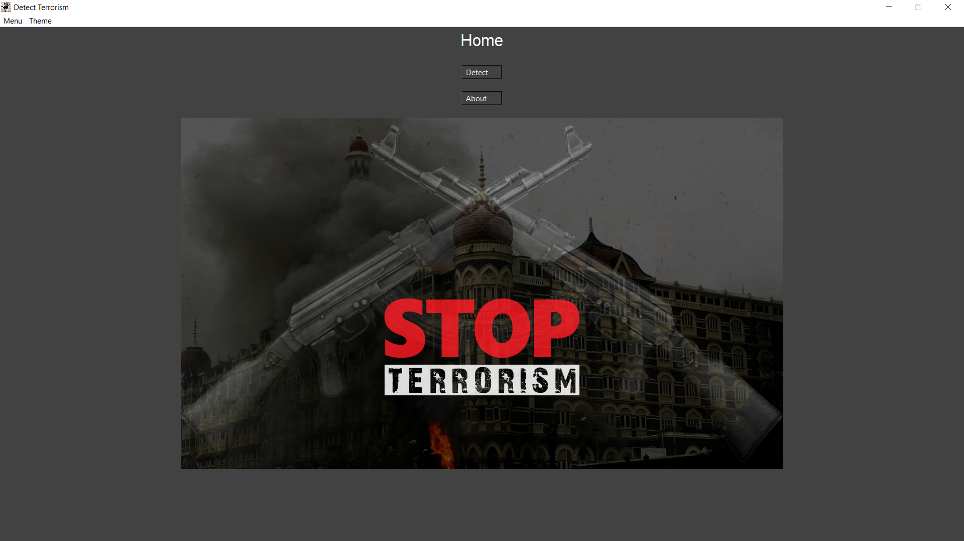
UI Screens
Home

Slide 11
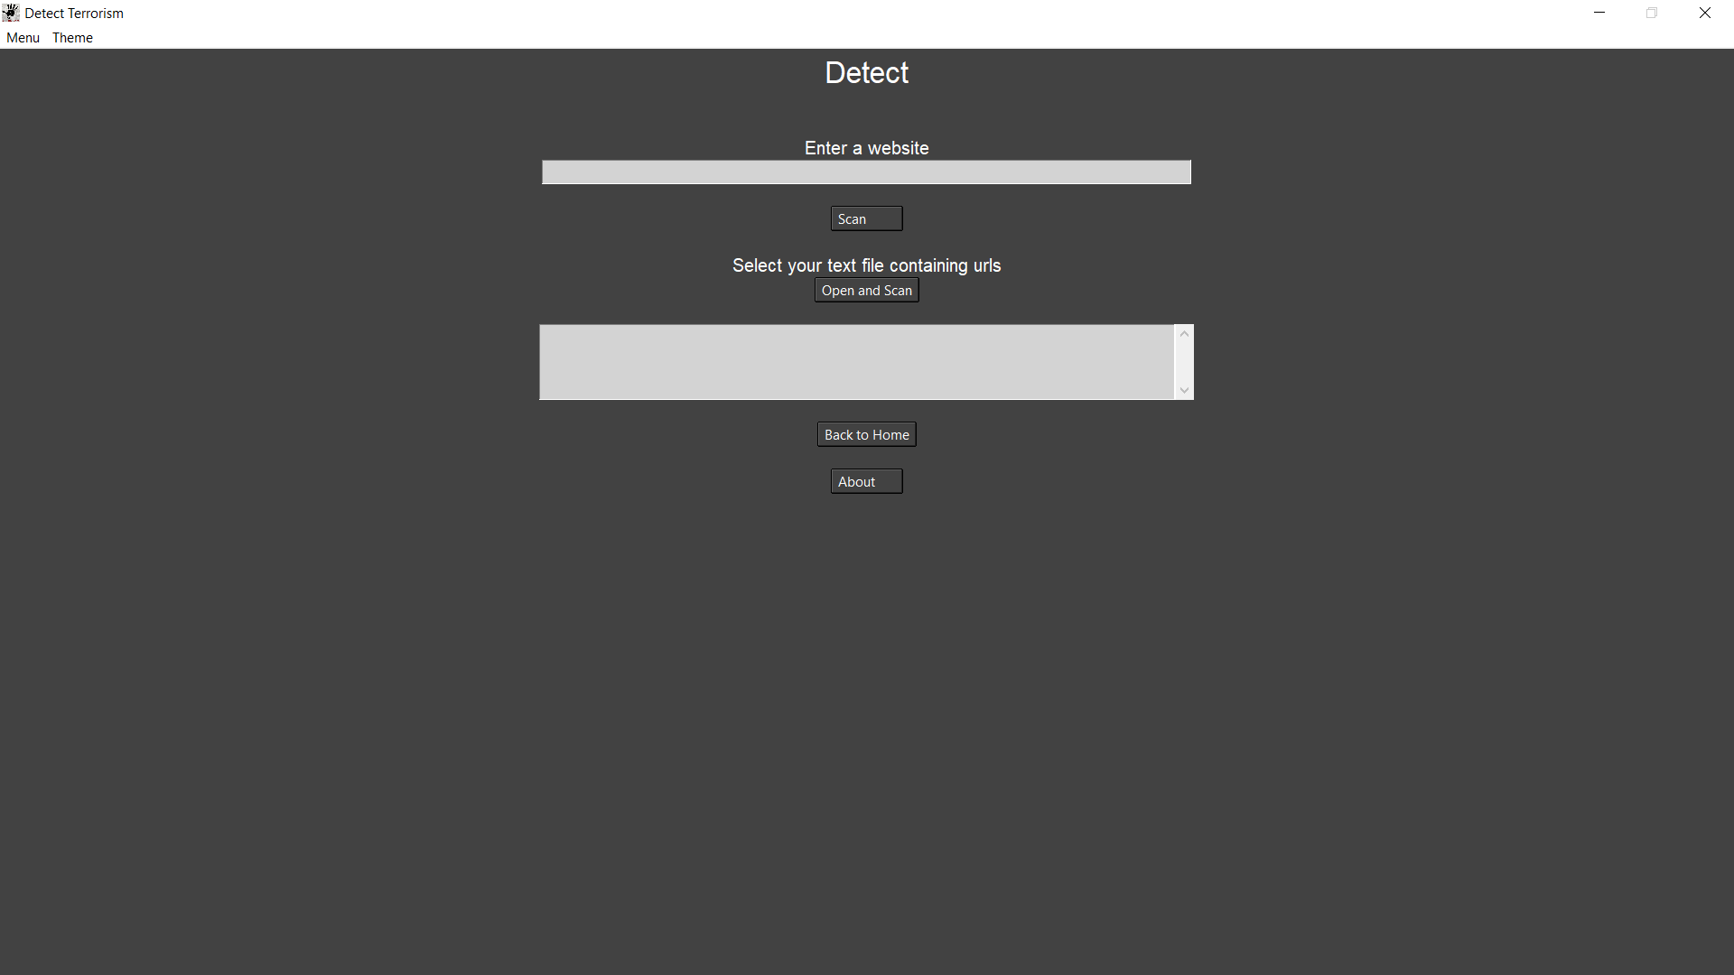
Detect

Slide 12
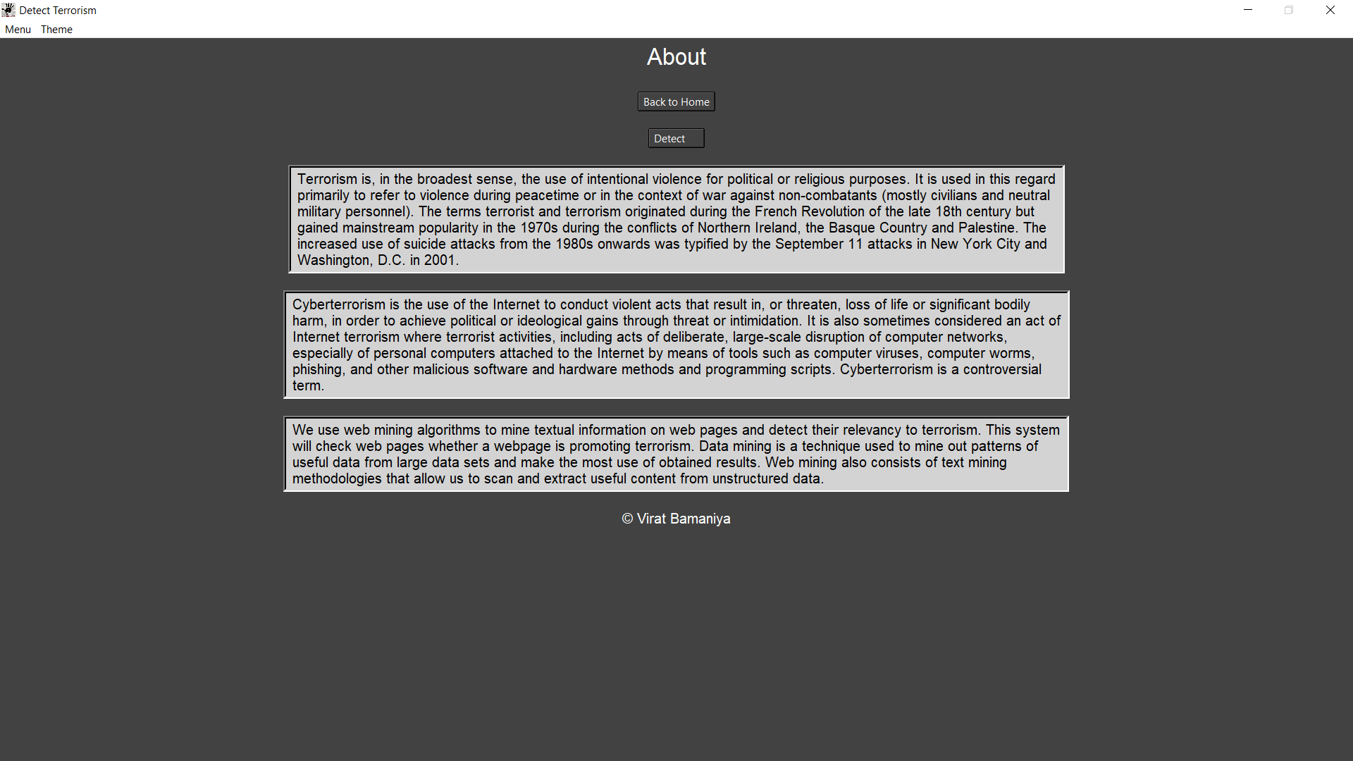
About

Slide 13



Timeline Chart
Testing & Finalizing
05
Enhancements
04
Documentation
03
Coding
02
Design
01
Analysis
Q1
Q2
Q3
Q4
Q1
Q2
Q3
Q4
September
October
November
December

Slide 14
Future Enhancements
As many terrorists communicate in keywords, there can be module where terrorists communicating in code words can be tracked by the system itself.
We can display which keywords match.
If multiple webpages are scanned at a time, they can be ranked based on their severity (keywords matched).

Slide 15
Web References
https://stackoverflow.com/
https://www.geeksforgeeks.org/
https://www.crummy.com/software/BeautifulSoup/bs4/doc/
https://www.javatpoint.com/
https://docs.python.org/3/
https://www.tutorialspoint.com/index.htm
https://www.youtube.com

Slide 16
Thank you

